Slide 1
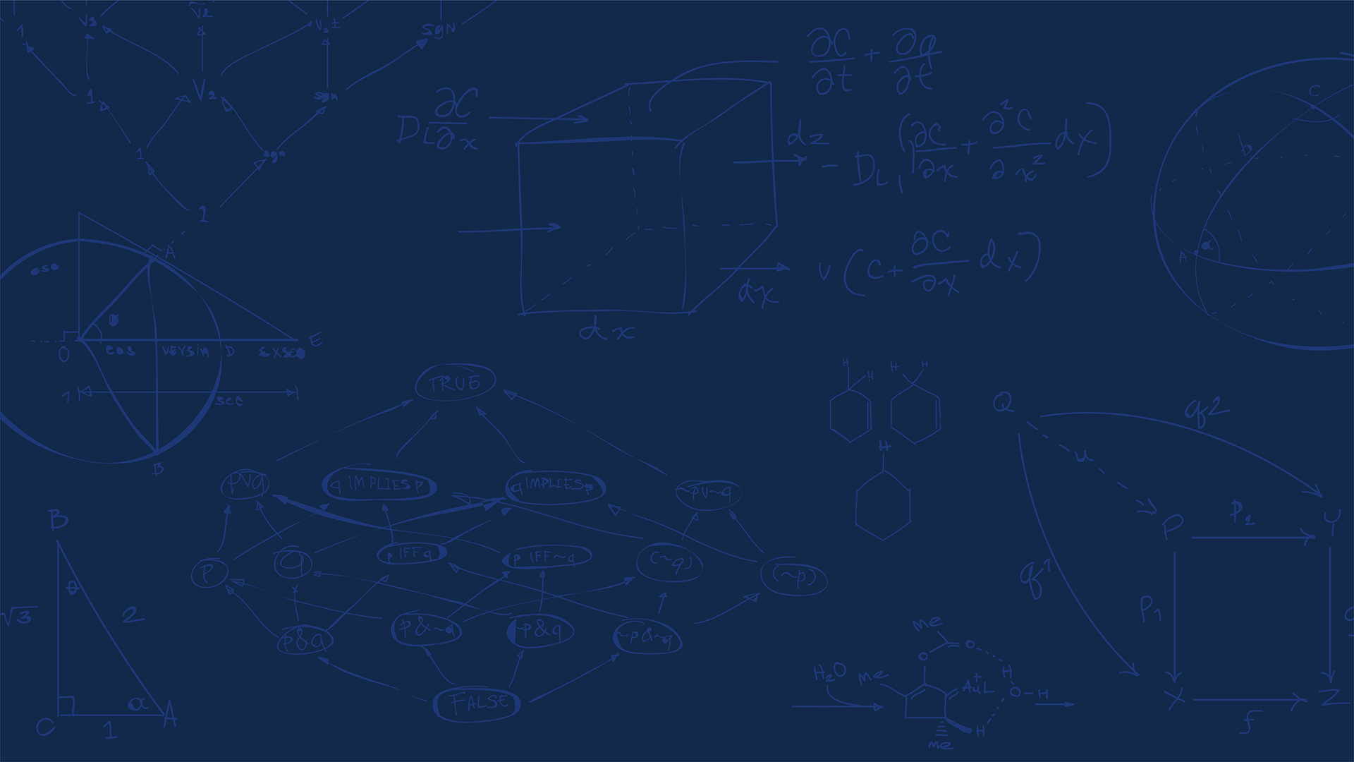
Safe RL for Drone Navigation Using Constrained PPO
Shishir Bhatta
AE598: Reinforcement Learning
12/9/2026

Slide 2
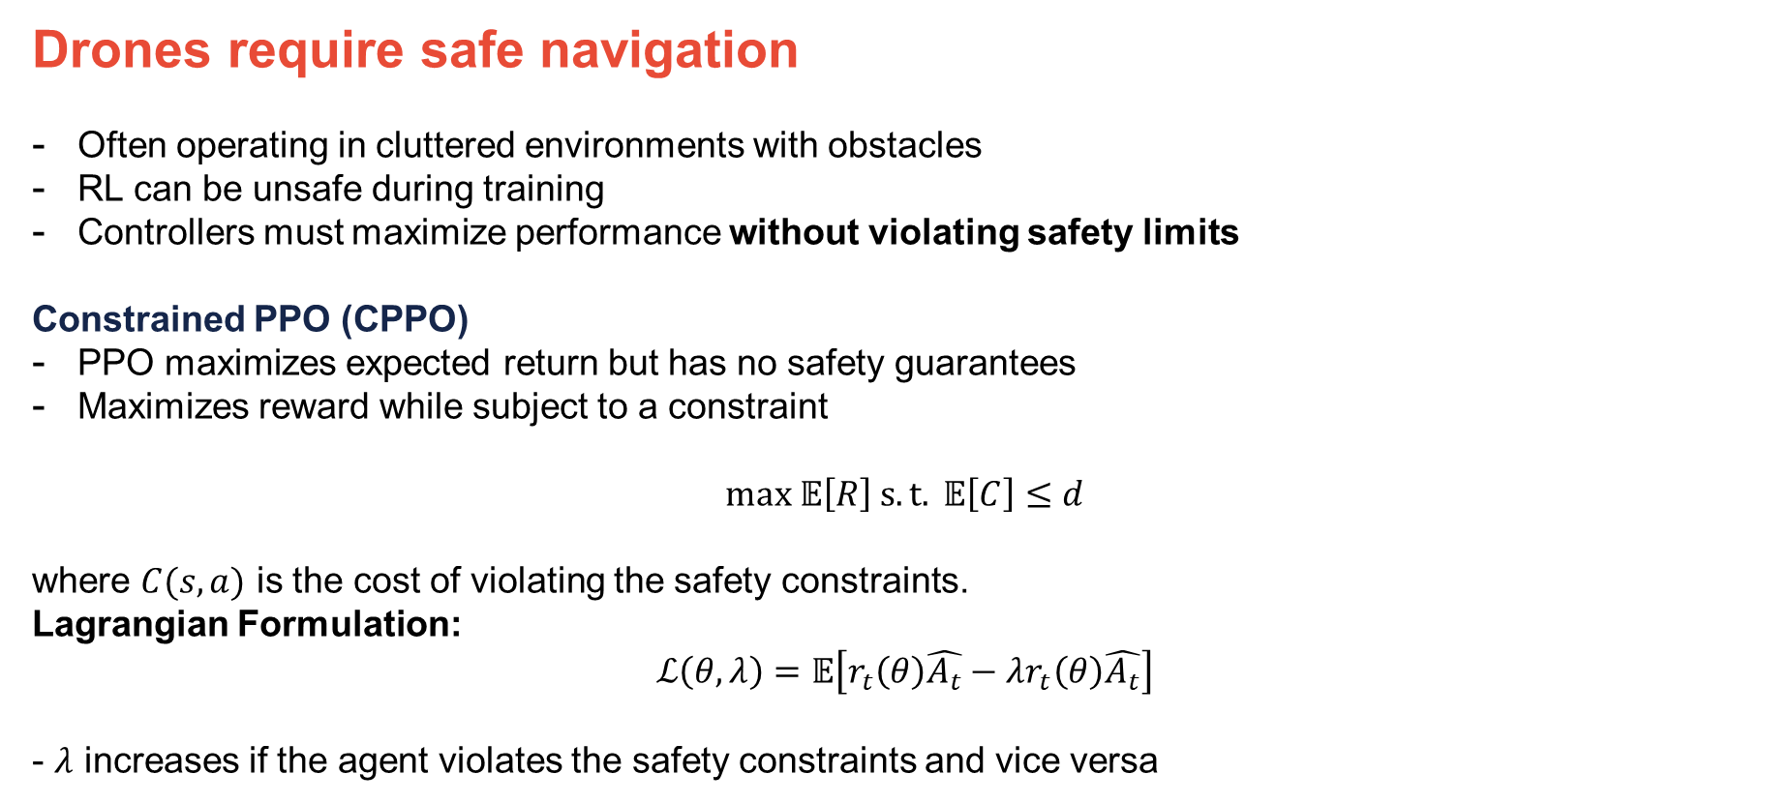

Motivation
Drones require safe navigation
Often operating in cluttered environments with obstacles
RL can be unsafe during training
Controllers must maximize performance without violating safety limits
Constrained PPO (CPPO)
PPO maximizes expected return but has no safety guarantees
Maximizes reward while subject to a constraint
$$max 𝔼\left[R\right] s.t. 𝔼\left[C\right]≤d$$
where $C(s,a)$ is the cost of violating the safety constraints.
Lagrangian Formulation:
$$ℒ\left(θ,λ\right)=𝔼\left[r_{t}\left(θ\right)\hat{A_{t}}−λr_{t}\left(θ\right)\hat{A_{t}}\right]$$
- $λ$ increases if the agent violates the safety constraints and vice versa
$$π$$
AEROSPACE ENGINEERING
GRAINGER ENGINEERING

Slide 3
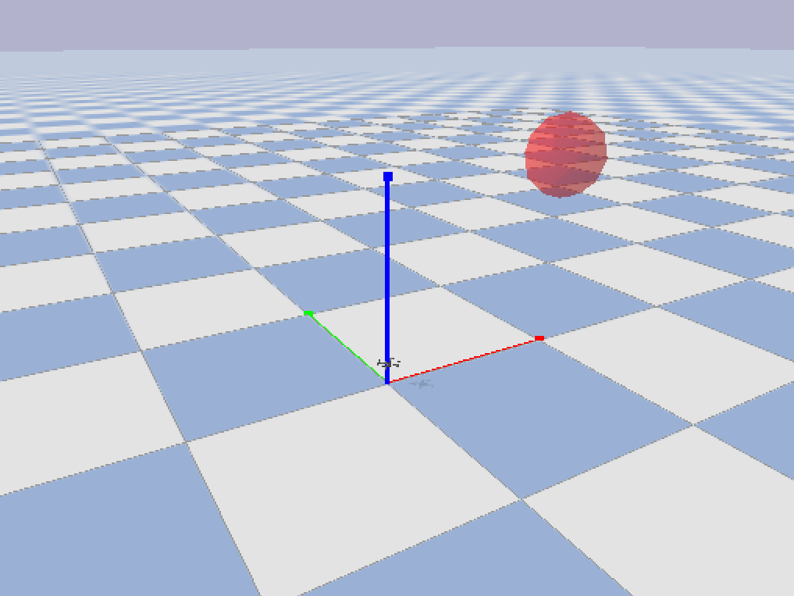
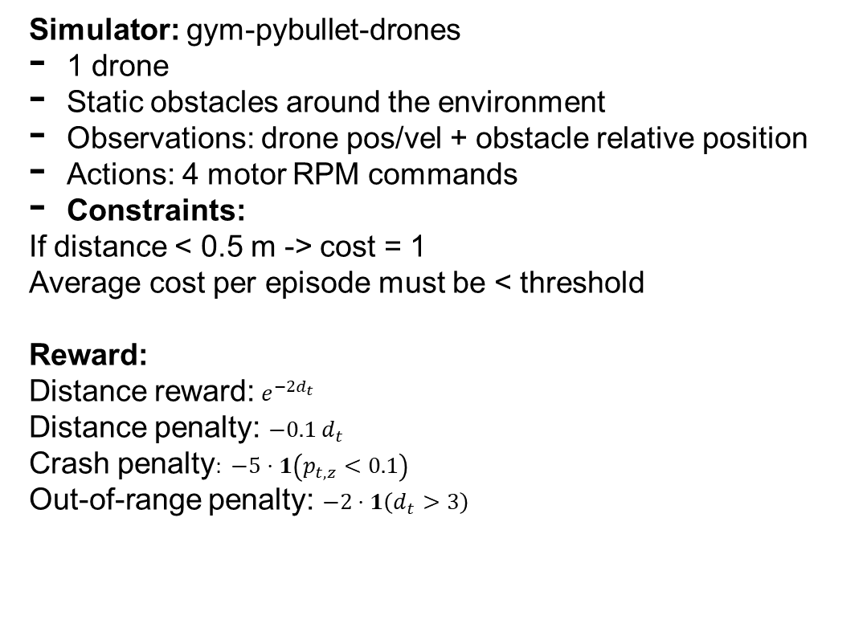
Environment
Simulator: gym-pybullet-drones
1 drone
Static obstacles around the environment
Observations: drone pos/vel + obstacle relative position
Actions: 4 motor RPM commands
Constraints:
If distance < 0.5 m -> cost = 1
Average cost per episode must be < threshold
Reward:
Distance reward:$e^{−2d_{t}}$
Distance penalty: $−0.1 d_{t}$
Crash penalty$: −5⋅1\left(p_{t,z}<0.1\right)$
Out-of-range penalty: $−2⋅1\left(d_{t}>3\right)$
Environment
AEROSPACE ENGINEERING
GRAINGER ENGINEERING

Slide 4
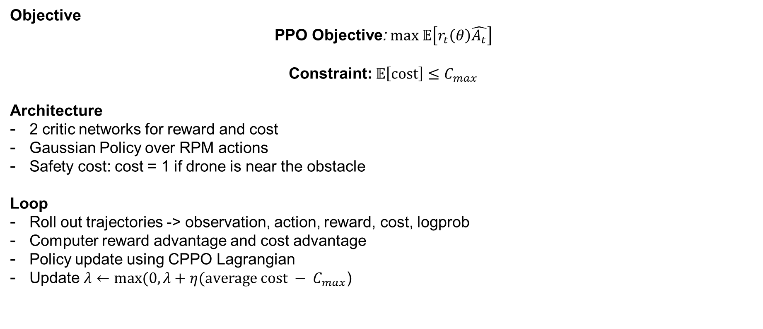

Training
Objective
PPO Objective: $max 𝔼\left[r_{t}\left(θ\right)\hat{A_{t}}\right]$
Constraint: $𝔼\left[cost\right]≤C_{max}$
Architecture
2 critic networks for reward and cost
Gaussian Policy over RPM actions
Safety cost: cost = 1 if drone is near the obstacle
Loop
Roll out trajectories -> observation, action, reward, cost, logprob
Computer reward advantage and cost advantage
Policy update using CPPO Lagrangian
Update $λ←max(0,λ+η(average cost − C_{max}$)
$$θ$$
AEROSPACE ENGINEERING
GRAINGER ENGINEERING

Slide 5
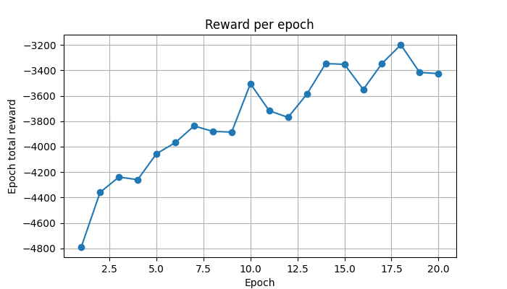
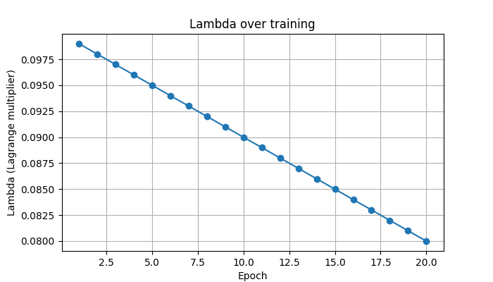
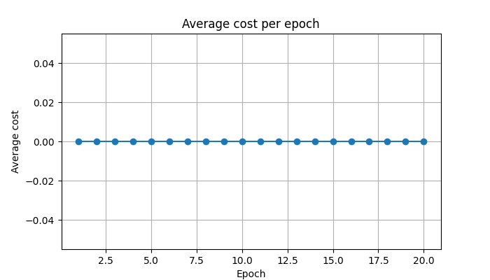
Results
Average cost per epoch remains at 0, which means safety is never violated
Average reward per time step was ~-1.75
Generally making progress at each epoch
Highly complex environment that needs more epochs to train on
Parameters need tuning to get best result
AEROSPACE ENGINEERING
GRAINGER ENGINEERING

Slide 6
CPPO successfully enforces safety by avoiding the obstacle.
Tuning parameters may make it perform better and reach the goal
Multi-agent systems can use this to safely navigate their environments without crashing.
Further work would be comparing this against PPO and other algorithms to see how it fares.
IMAGE
AEROSPACE ENGINEERING
GRAINGER ENGINEERING

Slide 7
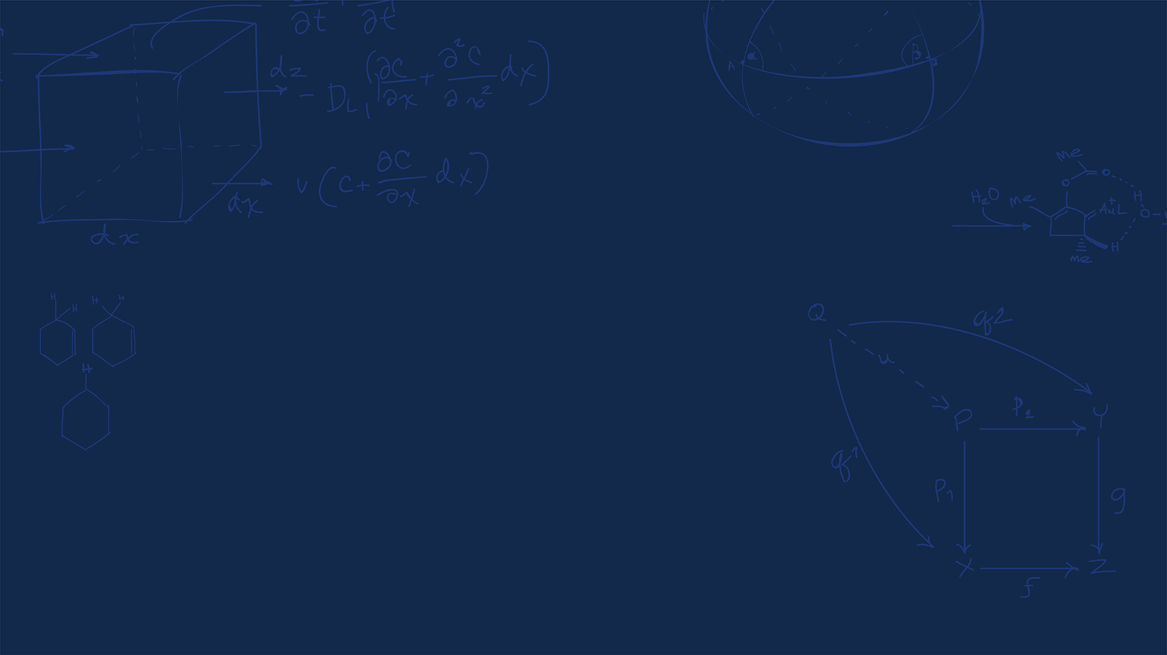
Questions?
AEROSPACE ENGINEERING
GRAINGER ENGINEERING

